Slide 1
Beer and Brewery
Tadd Backus & Austin Webb
June 14, 2022

Slide 2
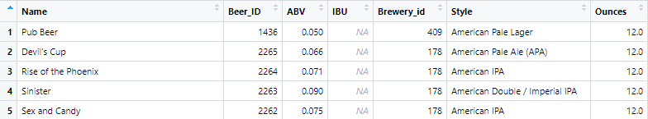
What is the Data?
Beer Dataset:
Name: Name of the beer
Beer_ID: Unique identifier of the beer
ABV: Alcoholic by volume of the beer
IBU: International bitterness units of the beer
Brewery_ID: Brewery id associated with the beer
Style: Style of the beer
Ounces: Ounces of beer

Slide 3
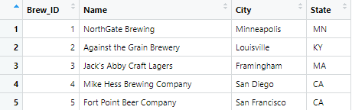
What is the Data?
Brewery Dataset:
Brew_id: Unique identiiers of the brewery
Name: Name of the brewery
City: City where the brewery is located
State: U.S. state where the brewery is located

Slide 4
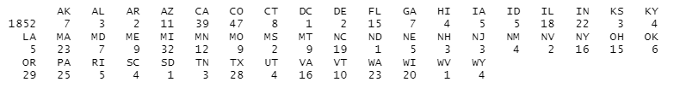
How Many Breweries in Each State
We see that there are a lot (1852) breweries not connected to a state
The state with the most breweries is Colorado (47)
Next is California (39)

Slide 5
How Many Breweries in Each State
Better visualization of the states and the number of breweries in each one

Slide 6
Address the Missing Values
ABV has 62 missing values
IBV has 1005 missing values
Deleted the observations with missing values

Slide 7
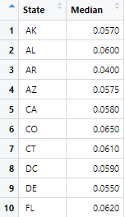
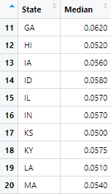
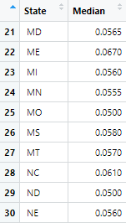
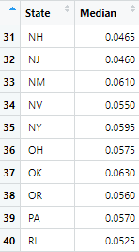
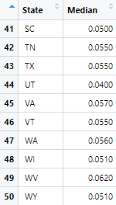
Median ABV for Each State
We can see the median ABV for each state

Slide 8
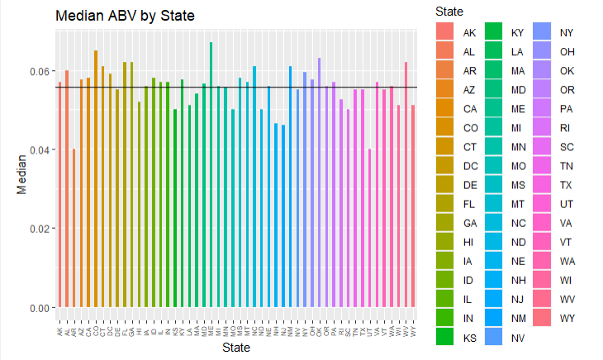
Median ABV for Each State
We can visually see how each state’s median ABV compares to each other
Horizontal line is the mean (0.05564)

Slide 9
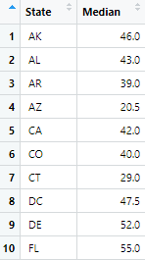
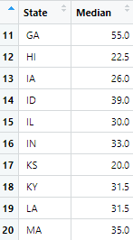
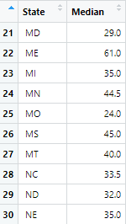
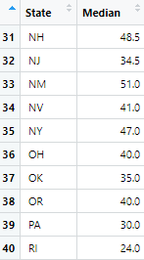
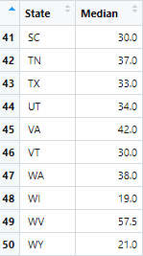
Median IBU for Each State
We can see the median IBU for each state

Slide 10
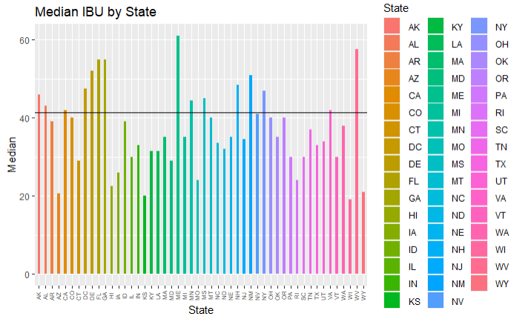
Median IBU for Each State
We can visually see how each state’s median IBU compares to each other
Horizontal line is the mean (41.4151)

Slide 11
Max ABV
Max ABV is found in Louisville, Kentucky
Max ABV is 0.125

Slide 12
Max IBU
Max IBU is found in Astoria, Oregon
Max IBU is 138

Slide 13
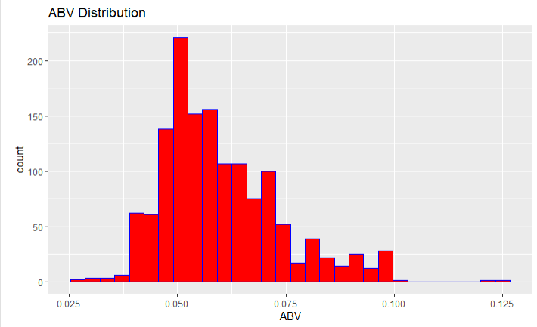
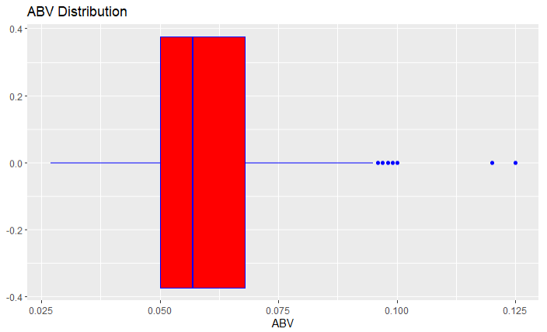
ABV Statistics
Minimum: 0.027
1st Quarter: 0.05
Median: 0.057
Mean: 0.05991
3rd Quarter: 0.068
Max: 0.125

Slide 14
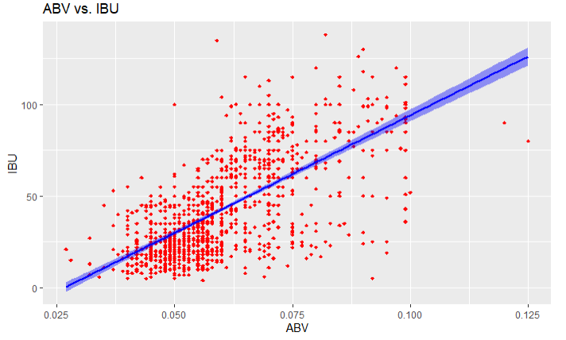
Relationship Between ABV and IBU
The correlation coefficient is 0.6706
This suggests that ABV and IBU moderately influence the other. As one increases, the other also increases.

Slide 15
Future of the Project
We would like to further our investigation the difference with respect to ABV and IBU between IPAs and other ales.
We also conducted all the previous tests and plots with the missing values imputed as the mean of those columns.
We would like to see if there is significant difference between the ways we deal with the missing values.

